Slide 1

WELCOME!

Slide 2

CODING WITH
RIAK
Where to start
and where it leads you
3/17/15
Matt Brender
Developer Advocate

Slide 3


Slide 4
git clone riak-dev-cluster
https://github.com/basho-labs/riak-dev-cluster
(Anybody!)
Notes:
https://github.com/basho/riak-dev-cluster

Slide 5
git clone little_riak_book
https://github.com/coderoshi/little_riak_book
/tree/master/rendered/
(No code needed!)

Slide 6
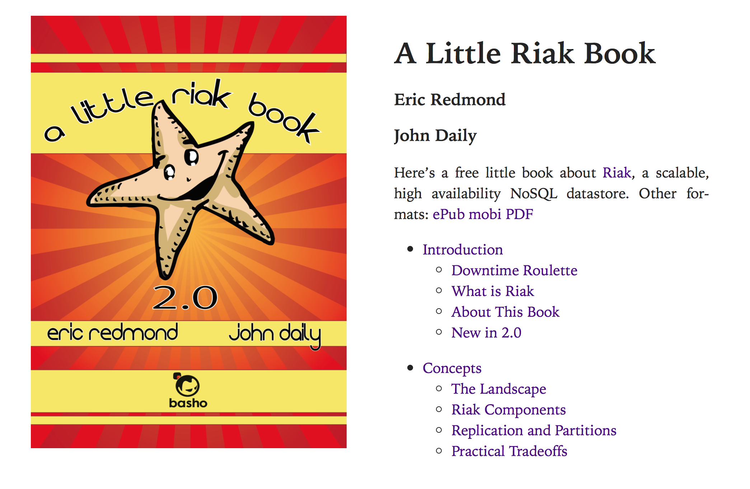

Slide 7
riak-app (new!)
http://basho.s3.amazonaws.com/Riak204.dmg
(Mac peeps)

Slide 8


Agenda
NoSQL World
What’s Riak
Taste of Riak
Prototyping
Scaling, etc
Notes:
The first 4 will take about ~35-40 minutes. We’ll then take an intermission to re-up on food and drink. Then the dev heavy logic will be another 35 or so.

Slide 9

NoSQL Types
http://docs.basho.com/riak/latest/theory/comparisons/
Notes:
KV:
Examples: Cassandra, DyanmoDB, Azure Table Storage (ATS), Riak, BerkeleyDB.
Give it a key and value, it saves the value
Give it a key, it returns the value
Does not care what the value is
Data modeling reversed – instead of model to view, start w view.
Continuum – complexity of the query planner, vs scaling. YOU are the query planner
Document:
Examples: MongoDB, CouchDB
Wide Column:
Examples include: HBase, BigTable and HyperTable. (also Cassandra)
instead of storing data in rows, these databases are designed for storing data tables as sections of columns of data, rather than as rows of data
Graph:
Based on graph theory, these databases are designed for data whose relations are well represented as a graph and has elements which are interconnected, with an undetermined number of relations between them.
Examples include: Neo4J and Polyglot.
Time Series:
Examples: InfluxDB, OpenTSDB
optimized for handling time series data, arrays of numbers indexed by time (a datetime or a datetime range).

Slide 10
Why NoSQL?

Slide 11
“Big Data”

Slide 12
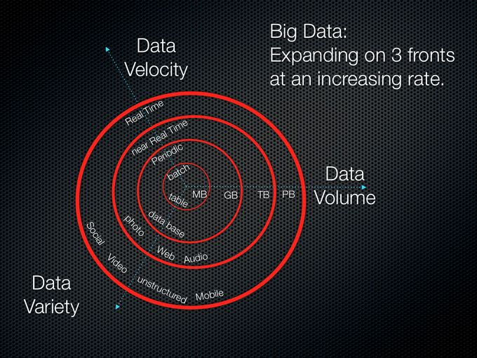
“Big Data”

Slide 13
IoT

Slide 14

IoT
Notes:
A.k.a. “Now everything in your house will need security updates that you will ignore”

Slide 15

“Weather changes, and so must IT.”
Notes:
commented Bryson Koehler, executive vice president and CIO, The Weather Company.
from: http://basho.com/the-weather-company-deploys-basho-riak-for-next-generation-forecast-and-data-services-platform/

Slide 16


BASHO DEVELOPS
DISTRIBUTED SYSTEMS
Open Source
Distributed NoSQL Database
Commercial
Distributed NoSQL Database
Notes:
So, what’s Riak??

Slide 17
Key => Value
val1 = 1
obj1 = my_bucket.new('one')
obj1.data = val1
obj1.store()
Notes:
Give it a key and value, it saves the value
Give it a key, it returns the value
Does not care what the value is
Data modeling reversed – instead of model to view, start w view.
Continuum – complexity of the query planner, vs scaling. YOU are the query planner.

Slide 18

A note on buckets
my_bucket = client.bucket("test”)
Notes:
Riak 2 uses bucket types to enable groups of similar buckets to share properties, configuration, and to namespace values within those buckets. Bucket type support is integral to how CRDTs work.
In versions 2.2.0 and newer of this client, bucket types have a first-class representation, and can be used to create BucketTyped::Bucket objects that are namespaced differently from regular Riak::Bucket objects.
Give it a key and value, it saves the value
Give it a key, it returns the value
Does not care what the value is
Data modeling reversed – instead of model to view, start w view.
Continuum – complexity of the query planner, vs scaling. YOU are the query planner.

Slide 19
Masterless
client = Riak::Client.new(:nodes => [
{:host => '10.0.0.1'},
{:host => '10.0.0.2', :pb_port => 1234},
{:host => '10.0.0.3', :pb_port => 5678}
])
Notes:
This ruby code will automatically balance calls across the three nodes in this cluster. What’s important is that all of these nodes are identical in the system – they “own” some section of the overall namespace, but they accept R & W for any set of data.

Slide 20
Fault Tolerant
& Highly Available
Notes:
- through distribution
- through replication
- enabled by Erlang/OTP
- masterless
- Survives
- Node failure
- Network partition
- Software failures
- Any node can serve client requests
- fallbacks are used when nodes are down
- Always accepts reads and writes
- Even in failure states
- Low latency
- Per-request quorums

Slide 21
Ops-friendly
riak-admin cluster join
or
riak-admin cluster leave
Notes:
Easy to scale “Just Add a Machine”
Rolling restarts/upgrades – upgrade the OS or Riak with 0 downtime for the cluster as a whole
Lends itself well to config mgmt tools (Ansible / Puppet / Chef)
Monitoring/alerting tools
Full admin commands: http://docs.basho.com/riak/latest/ops/running/tools/riak-admin/

Slide 22
Queries & Search
Riak::MapReduce.new(client).
add("artists","Beatles").
link(:bucket => "albums").
map(*).run
Notes:
# Assuming you've already instantiated a client, get the album titles for The Beatles
Command in the * = "function(v){ return [JSON.parse(v.values[0].data).title];
p results # => ["Please Please Me", "With The Beatles", "A Hard Day's Night",
# "Beatles For Sale", "Help!", "Rubber Soul",
# "Revolver", "Sgt. Pepper's Lonely Hearts Club Band", "Magical Mystery Tour",
# "The Beatles", "Yellow Submarine", "Abbey Road", "Let It Be"]

Slide 23
Search in Riak
Riak Search
Secondary Indexes
MapReduce
Apache Solr full-text search
Support for Solr’s client query APIs
Tag objects with one or more query values
Index integers or strings
Exact matches or ranges of values
Filter documents by tag
Count words in documents
Extract links to related data

Slide 24


What makes Riak
unique
Scalability
Low-Latency
High Availability
Fault-Tolerance
Operational Simplicity
Multi-Model
Multi- Datacenter Replication
SNMP & JMX monitoring
24x7 Customer Support
Notes:
What makes Riak unique is it
Handles massive data scale in production
Expands easily and scales for geographically disbursed locations reducing latency for end users
Highly available architecture enables any node to service read or write requests
Integration with Riak CS and Apache Solr provides multi-model support from a single platform

Slide 25







Developing for Riak
Animated
choose your own language
Notes:
ANIMATION – gologo jumps in to talk about community-driven development.

Slide 26
Developing for Riak
choose your style
Native APIs: • HTTP(S) • Protocol Buffers
Client Libraries: • Your Favorite Language
Notes:
What’s a Protocol Buffer?
`
Protocol buffers are a flexible, efficient, automated mechanism for serializing structured data – think XML, but smaller, faster, and simpler. You define how you want your data to be structured once, then you can use special generated source code to easily write and read your structured data to and from a variety of data streams and using a variety of languages. You can even update your data structure without breaking deployed programs that are compiled against the "old" format.

Slide 27
Creating Object
$ curl -v http://localhost:8098/buckets/capitals/keys/usa
-X PUT
-H "content-type: text/plain"
-d "Washington D.C.”
* Trying 127.0.0.1... connected
> PUT /buckets/capitals/keys/usa HTTP/1.1
> Content-Type: text/plain
>
< HTTP/1.1 204 No Content

Slide 28
Retrieving Object
$ curl -v http://127.0.0.1:8098/buckets/capitals/keys/usa
Trying 127.0.0.1... Connected
> GET /buckets/capitals/keys/usa HTTP/1.1
< HTTP/1.1 200 OK
< X-Riak-Vclock: a85hYGBgzGDKBVIcR4M2cvvL1tzJYEpkzGNluGw/+QRfFgA=
< Vary: Accept-Encoding
< Server: MochiWeb/1.1 WebMachine/1.9.0 (someone had painted it blue)
< Link: </buckets/capitals>; rel="up"
< Last-Modified: Tue, 24 Jan 2012 14:44:35 GMT
< ETag: "1yAFlUinalK2zNd7LpkOgU”
Washington D.C.

Slide 29
Taste of Riak
https://github.com/basho/taste-of-riak
Notes:
Great code for introductions in your favorite languages. Most of the source we’ve shown here comes directly from there.

Slide 30
What Kind of Data Are You Storing?
Notes:
http://docs.basho.com/riak/latest/dev/using/application-guide/

Slide 31
Riak Use Cases
Application Type | Key | Value
Session | User/Session ID | Session Data
Advertising | Campaign ID | Ad Content
Logs | Date | Log File
Sensor | Date, Date/Time | Sensor Updates
User Data | Login, email, UUID | User Attributes
Content | Title, Integer | Text, JSON/XML/HTTP document, images, etc.

Slide 32


















Riak Use Cases
Public Cloud
Gaming and Betting
Private Cloud
Telecommunications
SaaS / Data Services
Mobile Payments
Digital Media
Social Network
Display Advertising
Consumer Goods
Airlines
Health Care
On-Line Gaming
Weather
Retail and e-Commerce
PaaS Implementation
Internet of things
Supply Chain
Notes:
User Activity
Session Data
Location Data
Content management and distribution
Device data or IOT
Point-of-Sale
Flash Retail
Ad Networks
Product Catalog
Recommendations Engine
Mobile Payments
Health Monitoring
Health Records
Supply Chain Visibility

Slide 33
How are you Modeling your data?
Notes:
What’s your key. What’s your value. What data is worth calculating is a secondary bucket for quick retrieval. What can be ignored. What needs to be fast what can be slow.
There are more questions to be uncovered than answered when you first get into modeling.

Slide 34
So, NoSQL…

Slide 35

SO WHY SHOULD I CARE
Why use riak

Slide 36
Prototyping

Slide 37
Prototyping
how Riak makes it easier
Schema-less {no updates to table structure}
Store anything {text, images, binaries}
Scaling for free {no rewrites}
Solr: Full text search, geospatial, etc
Notes:
- Schema-less: no updates to table structures, which also means: no required migration of all the previous records that were stored.

Slide 38




Prototyping
Getting going locally
$ apt-get install riak ( Ubuntu, custom apt repo)
OR
$ brew install riak ( Mac OS X )

Slide 39
Prototyping
Getting going locally
Port 11098
riak-dev-cluster
YOUR
CODE
HERE
/vagrant

Slide 40
Schema-less
But what about schema migrations?
1) Lazy-migration (on load)
2) Last resort: Batch migration
(cron jobs, etc)
Notes:
If you’re storing JSON objects and find

Slide 41
Scale

Slide 42


Scaling Up
why you should care
Fear Success
no more

Slide 43
Scaling Up
why you should care

Slide 44
Scaling Up
from one to many
From laptop to cluster without changing settings

Slide 45
Scaling Up
from one to many
From laptop to cluster without changing settings
^ code
Notes:
No rearchitecting the database (shards, replica sets, etc)

Slide 46
Prototyping
Getting going
Local
Test/Dev
Prod
=>
=>

Slide 47


Closing Thoughts
NoSQL offers various optimizations for scale
Riak plays nice in your favorite language
Scale from from local prototype to dev to prod
Valuable comes from fitting the use case
Notes:
Profile. What do we know about our users?

Slide 48
Spend Time
getting to know us
github.com/basho-labs
&
docs.basho.com

Slide 49


